Slide 1

NAME:NDAHABONIMANA DANIEL
REG:25RP18098
TOPIC:TENANT MONITORING AND RENT PAYMENT PREDICTION SYSTEM USING MULTIPLE REGRESSION
DATASET LINK:https://www.kaggle.com/datasets/iamsouravbanerjee/house-rent-prediction-dataset

Slide 2
Problem Statement
Landlords often face challenges in determining whether tenants will pay rent on time. Rental prices are influenced by several factors such as size, location, and furnishing status. Manual estimation of rent is difficult and often leads to inaccurate decisions. This project develops a prediction system using multiple regression to estimate rent and payment reliability.

Slide 3
Dataset Description
The dataset contains the following columns:
The dataset for this project comprises detailed rental property listings, serving as the foundation for predicting housing costs. It includes a mix of numerical and categorical features that capture the key attributes of a rental unit. The numerical attributes are BHK (number of bedrooms, hall, and kitchen), Size (in square feet), and Bathroom count, which provide a quantitative basis for the property's capacity and space. These are complemented by several descriptive categorical attributes that add crucial context, such as the City, specific Area Locality, and Area Type (e.g., Super Area, Carpet Area), which are vital for establishing a property's location and layout. Further details include the Furnishing Status (Furnished, Semi-Furnished, Unfurnished), the type of Tenant Preferred (Bachelors/Family), the Point of Contact (Agent, Owner), and Floor information. The date the listing was made is also recorded under Posted On. The central goal of the model is to analyze the complex interplay between all these features to accurately predict the final column, Rent, which is the monthly rental price and our target variable.

Slide 4
BHK: Number of bedrooms, hall, kitchen
Size: Area in square feet
Bathroom: Number of bathrooms
Furnishing Status: Furnished / Semi-Furnished / Unfurnished
Tenant Preferred: Type of tenant
City & Area Locality: Location of property
Posted On: Date listed
Area Type: Super Area, Built-up Area, Carpet Area
Floor: Floor number
Rent: Monthly rent (target variable)

Slide 5
Exploratory Data Analysis (EDA) Findings
Rent Distribution: Rent values are positively skewed, with most properties having lower to mid-level rents, and fewer very high rent properties.
Size vs. Rent: Larger property size is strongly correlated with higher rent.
BHK & Bathrooms: Properties with more bedrooms and bathrooms generally attract higher rent.
Location Factor: Rent varies significantly across cities and localities, showing that location is a key determinant.
Furnishing Status: Fully-furnished houses tend to have higher rents compared to semi-furnished and unfurnished.
Outliers: A few extreme high-rent values were detected and treated during preprocessing.

Slide 6
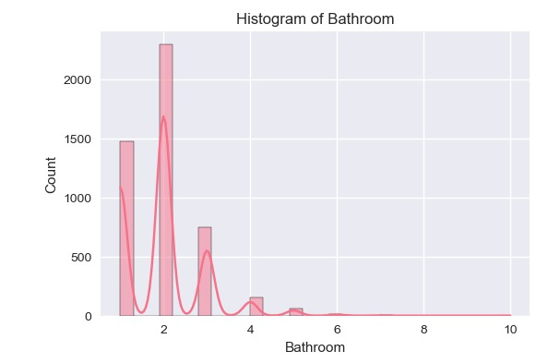

Slide 7
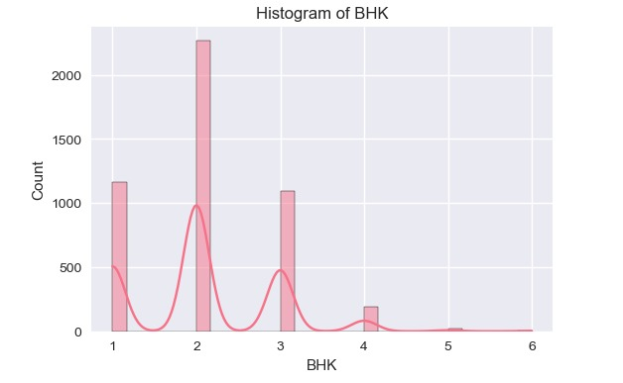

Slide 8
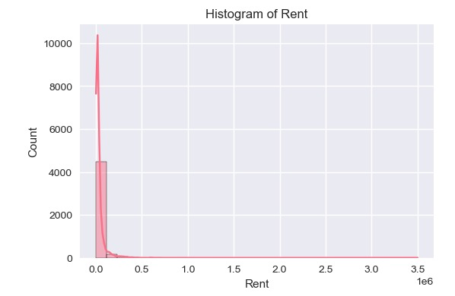

Slide 9
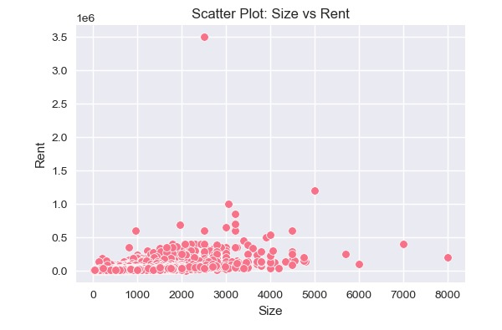

Slide 10
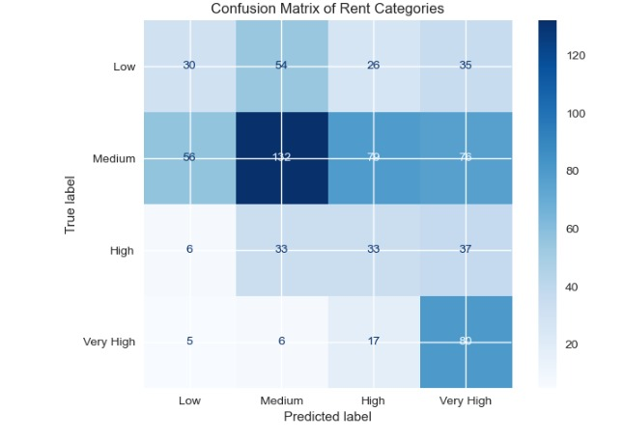

Slide 11
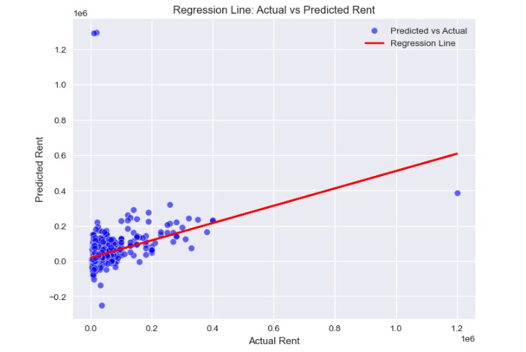

Slide 12
Feature Engineering & Justification
Encoding categorical variables: Converts text features like furnishing and tenant type into numeric values.
Date processing: Extract month/year features from 'Posted On'.
Normalization: Scale numerical features like Size and Bathroom count.
Justification: Improves model performance and accuracy by allowing regression to handle all features effectively.

Slide 13
Model Building & Evaluation
Model used: Multiple Linear Regression
Train-test split: 80%-20%
Evaluation metrics:
Mean Absolute Error (MAE)
Root Mean Squared Error (RMSE)
R² Score
Predicts expected rent based on tenant and property details

Slide 14
Model Deployment
Model deployed using Streamlit web application
Users can input tenant and property details interactively
Predicted rent and tenant reliability are displayed instantly

Slide 15
Methodology
Steps:
- Data preprocessing
- Feature selection
- Model training (Regression)
- Model saved with joblib
- Integration with Streamlit for predictions

Slide 16
System Design
Flow: Input Data → ML Model → Rent Prediction → Save History
Streamlit Sidebar used for tenant & property inputs
Results displayed dynamically in the app

Slide 17
Implementation
Tools:
- Python
- Pandas
- Scikit-learn
- Joblib
- Streamlit
- GitHub
Model deployed on Streamlit Cloud

Slide 18
Web App Features
✔ Predict tenant rent
✔ Save predictions to history
✔ Manage (delete) history records
✔ Simple and attractive UI
✔ Fully cloud-ready

Slide 19
Deployment
Steps:
- Code hosted on GitHub
- tenant_model.joblib included
- requirements.txt for dependencies
- Deployed via Streamlit Cloud

Slide 20
Results & Demo
Predicted rent displayed with success/error indicators.
Prediction history stored in tenant_history.csv.
User can delete old records interactively.

Slide 21
Conclusion
Benefits:
- Quick and reliable rent prediction
- Easy record management
Future Work:
- Add charts and analytics
- Improve model accuracy
- Add authentication system

Slide 22
References
1. Kaggle House Rent Dataset
2. Scikit-learn Documentation
3. Streamlit Documentation

